Slide 1



Book_Me
A .NET Core Web Application
https://github.com/alaeddine-hash/BookMe.net.git

Slide 2


Introduction
Welcome everyone, today I'm going to present 'BookMe', a web application built using the .NET Core MVC framework. It's designed to provide a user-friendly interface for book fans to explore and learn about various books

Slide 3

Purpose and Objectives
The aim of BookMe is to create a platform where users can browse a wide variety of books, view detailed descriptions, and sort books by themes. The objective of this project was to learn and apply .NET Core concepts in a real-world application

Slide 4

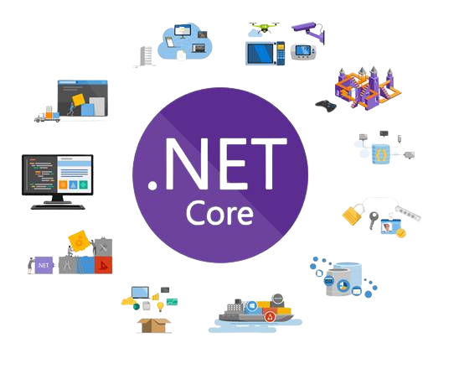



Technologies Used
The main technology used for this project is .NET Core. I used Entity Framework for database interactions, SQL Server for data storage, and Razor Views for dynamic HTML generation. The choice of these technologies was driven by their robustness, scalability, and seamless integration

Slide 5

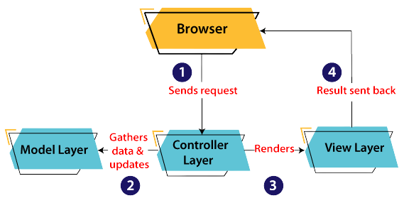
System Design
BookMe follows the MVC (Model-View-Controller) design pattern. Models define the data structure, views display the user interface and user interactions are handled by controllers. This separation of concerns makes the code modular, easy to manage, and enhances testability.

Slide 6
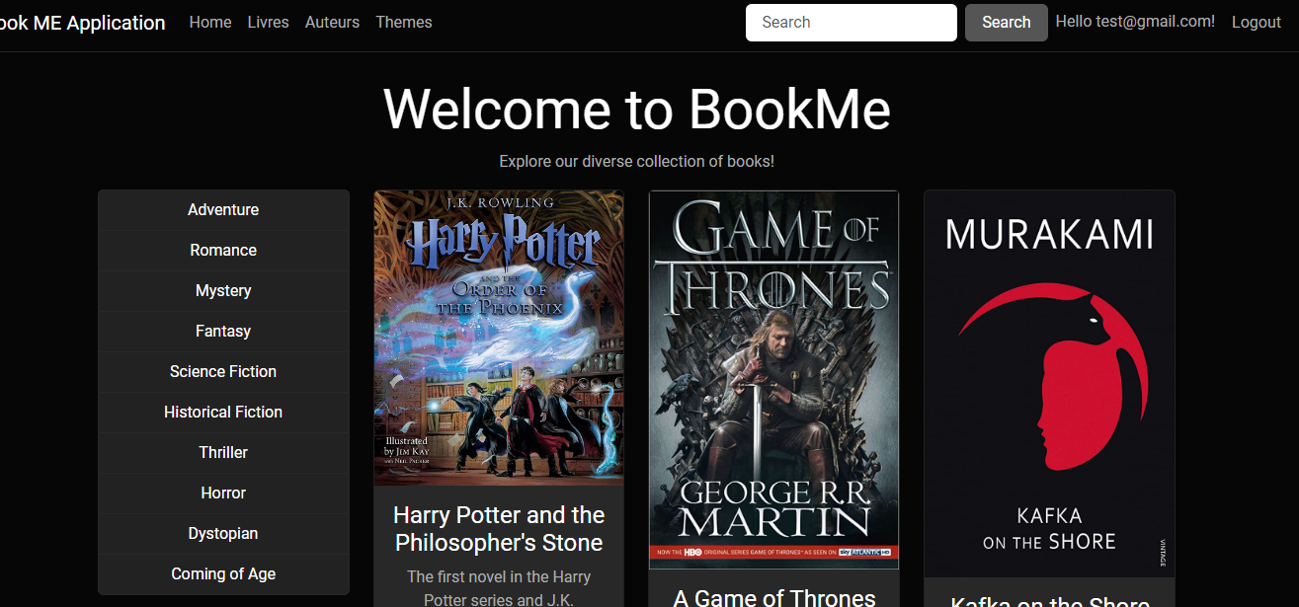
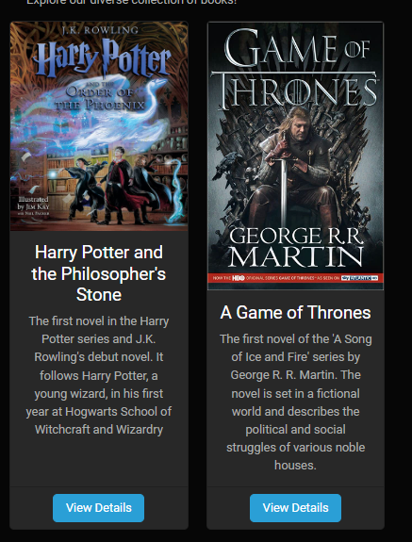
Core Features
BookMe allows users to browse books, view book details, and sort books by themes. The sorting feature enhances user experience by making it easy to find books in preferred genres or subjects.

Slide 7

Demo

Slide 8

Challenges and Solutions
One of the main challenges was to include security and to manipulate the views generated automaticly with razorViews. I like to think the help of the manager of the mini project.

Slide 9

future Enhancements
Looking forward, there are several possible enhancements for BookMe. These include a user login system, a rating system for books, and a feature to purchase books.

Slide 10
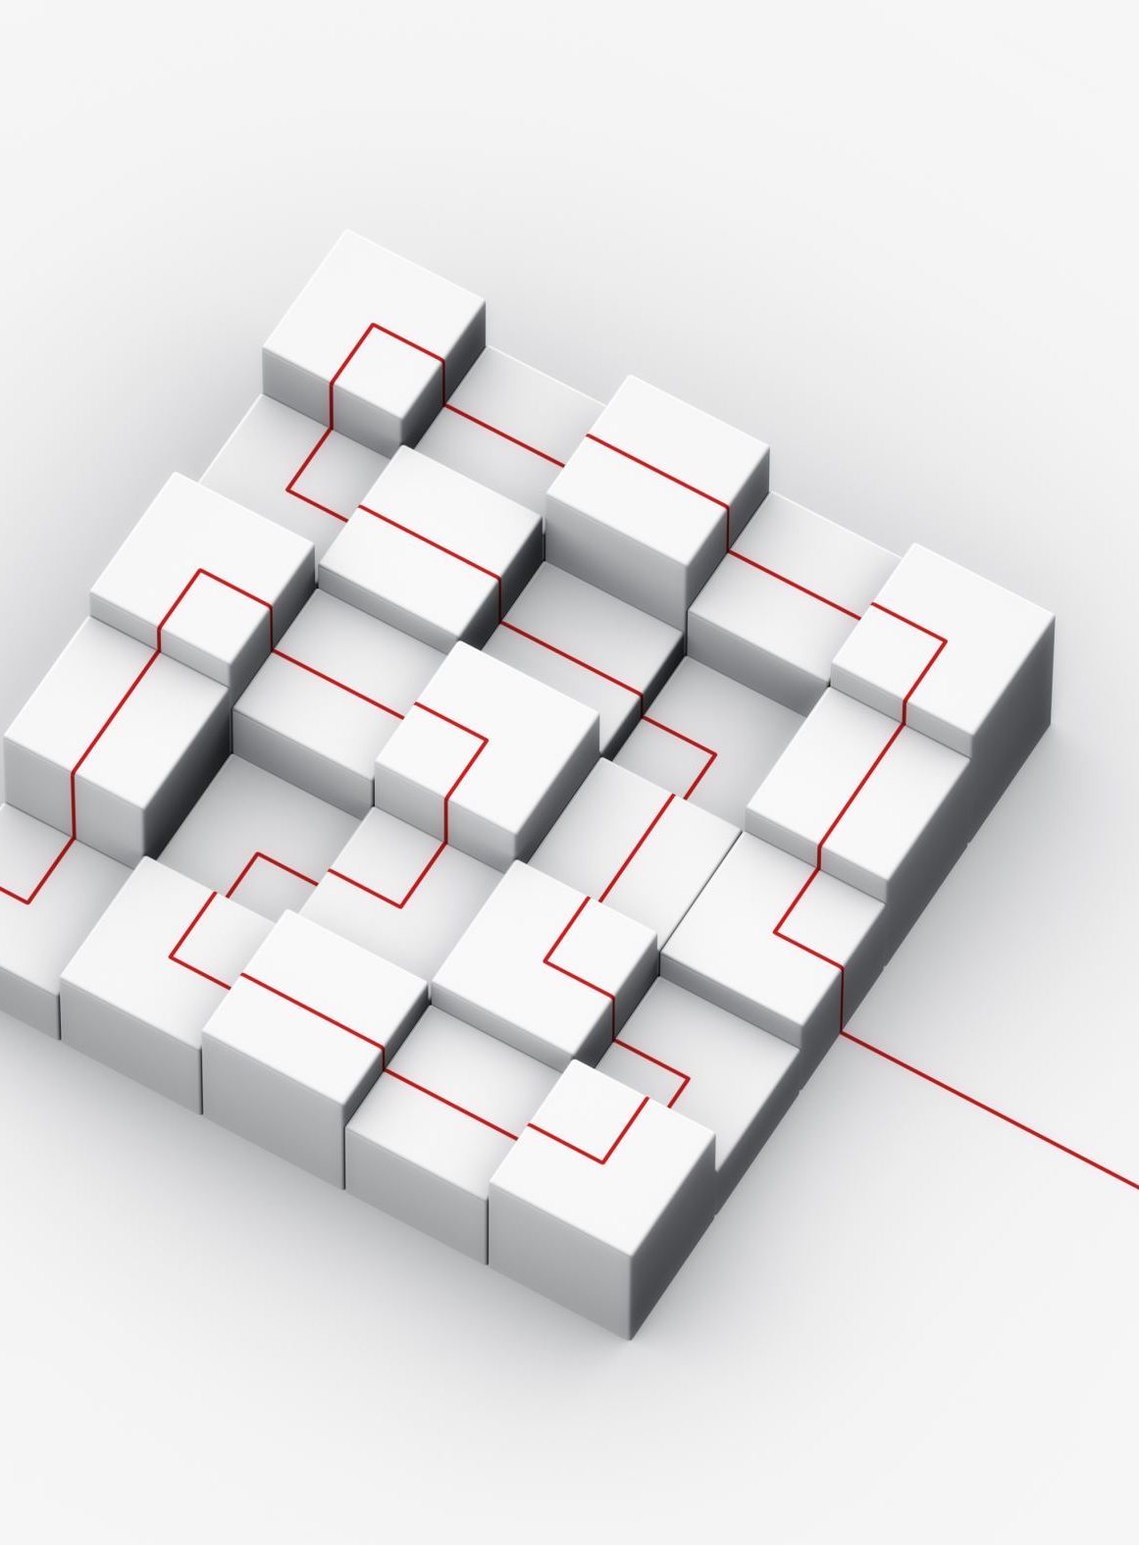
Conclusion
In conclusion, BookMe is a comprehensive .NET Core application that showcases efficient use of MVC architecture, database interactions with Entity Framework, and user interface design using Razor Views. I'm confident that this project has a strong potential to be expanded with additional features

Slide 11

Questions and Answers
Thank you for your attention. I'd be happy to answer any questions you might have.

